Slide 1
FUNCTION DEPENDENCY AND
TYPES & EXAMPLE
Sandeep kumar

Slide 2
DEFINATION
Functional dependency is a relationship that exists when one attribute uniquely determines another attribute. If R is a relation with attributes X and Y, a functional dependency between the attributes is represented as X->Y, which specifies Y is functionally dependent on X.
The attributes of a table is said to be dependent on each other when an attribute of a table uniquely identifies another attribute of the same table.

Slide 3
For example:
Suppose we have a student table with attributes: Stu_Id, Stu_Name, Stu_Age.
Here Stu_Id attribute uniquely identifies the Stu_Name attribute of student table because if we know the student id we can tell the student name associated with it.

Slide 4
Functional dependency and can be written as :
Stu_Id->Stu_Name .
we can say Stu_Name is functionally dependent on Stu_Id.
Formally:
If column A of a table uniquely identifies the column B of same table
then it can represented as A->B (Attribute B is functionally dependent on attribute A)

Slide 5
Types of Functional Dependencies
Trivial functional dependency
Non-trivial functional dependency
Multivalued dependency
Transitive dependency

Slide 6
Trivial functional dependency
The dependency of an attribute on a set of attributes is known as trivial functional dependency if the set of attributes includes that attribute.
Symbolically:
A ->B is trivial functional dependency if B is a subset of A.
The following dependencies are also trivial: A->A & B->B

Slide 7
For example:
Consider a table with two columns Student_id and Student_Name.
{Student_Id, Student_Name} -> Student_Id is a trivial functional dependency as Student_Id is a subset of {Student_Id, Student_Name}.
Also, Student_Id -> Student_Id & Student_Name -> Student_Name are trivial dependencies too.

Slide 8
Non-trivial functional dependency
If a functional dependency X->Y holds true where Y is not a subset of X then this dependency is called non trivial Functional dependency.

Slide 9
Example :
An employee table with three attributes: emp_id, emp_name, emp_address.
The following functional dependencies are non-trivial: emp_id -> emp_name (emp_name is not a subset of emp_id)
emp_id -> emp_address (emp_address is not a subset of emp_id)

Slide 10
On the other hand, the following dependencies are trivial:
{emp_id, emp_name} -> emp_name [emp_name is a subset of {emp_id, emp_name}]
Completely non trivial FD:
If a Functional dependency X->Y holds true where X intersection Y is Null then this
dependency is said to be completely non trivial function dependency.

Slide 11
Multivalued dependency
Multivalued dependency occurs when there are more than one independent multivalued attributes in a table.
a multivalued dependency is a full constraint between two sets of attributes in a relation. In contrast to the functional dependency, the multivalued dependency requires that certain tuples be present in a relation.

Slide 12
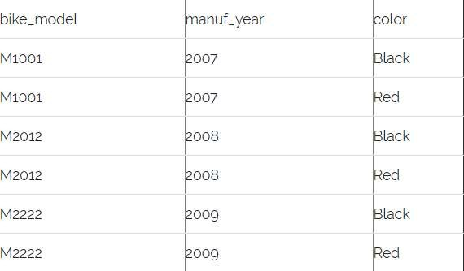
Consider a bike manufacture company, which produces two colors (Black and white) in each
model every year.

Slide 13
Here columns manuf_year and color are independent of each other and dependent on bike_model. In this case these two columns are said to be multivalued dependent on bike_model.
These dependencies can be represented like this:
bike_model ->> manuf_year
bike_model ->> color

Slide 14
Transitive dependency
A functional dependency is said to be transitive if it is indirectly formed by two functional dependencies.
X -> Z is a transitive dependency if the following three functional dependencies hold true:
X->Y
Y does not ->X Y->Z
A transitive dependency can only occur in a relation of three of more attributes. This dependency helps us normalizing the database in 3NF (3rd Normal Form).

Slide 15
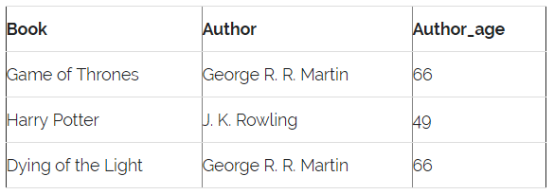
Example :-

Slide 16
{Book} ->{Author} (if we know the book, we knows the author name)
{Author} does not ->{Book}
{Author} -> {Author_age}
Therefore as per the rule of transitive dependency:
{Book} -> {Author_age} should hold, that makes sense because if we know the book name we can know the author’s age.

Slide 17
THANK YOU

